Slide 1


TELECOM ANALYSIS
KADIRI OLUWAFADEJIMI SARAH
DATE: MARCH 4, 2023

Slide 2
TABLE OF CONTENT
1. Introduction
2. Problem Statement
3. Methodology
4. Analysis 5. Insights 6. Recommendation

Slide 3
INTRODUCTION
CLIEF is a major telecom provider in Nigeria, and it, along with other telecom providers, unveiled 5G plans in May 2022

Slide 4
PROBLEM STATEMENT
CLIEF's business director asked that their analytics team provide a comparison report of key performance indicators (KPIs) before and after the 5G launch. The management is eager to compare the performance of these times in order to gain insights that will allow them to make informed decisions in order to recover their active user rate and other key metrics. They are also curious as to whether they can optimize their internet plans in order to attract more active customers.

Slide 5
METHODOLOGY
Approach and Timeline
May 30, 2022
June 2, 2022
June 6, 2022
June 8, 2022
1
2
3
4
Data and Requirement Gathering
-Data collection
- Understanding the business problem
Data Cleaning
-Exploratory data analysis
-Data quality issues
Data Analysis
Visualization
Reports
Analysis

Slide 6
ANALYSIS
Data Collection.
Octave Data Team provided the data used for this analysis on the 27th February 2023. The data is a record of hotel properties and metrics for the period of 3 months being January to September 2022.
Data Cleaning.
The following actions were performed in the process of cleaning the data using Power query in Power Bi:
The empty cells were replaced from null to zero using replace values.
The date dataset was formatted properly and some measures were added. The revenue and other metric values were formatted to currency.
Visualization.
The clean data was imported to Microsoft Power BI, in order to build visualizations that Provide Insights to the revenue team .
The following insights were generated from our analysis:
. METRICS BY CITY FOR BEFORE AND AFTER 5G IMPLEMENETATION
. MONTHLY TRENDS BEFORE AND AFTER 5G
.TOP PLANS BY REVENUE
. MARKET SHARE BY COMPANY AND MONTH

Slide 7
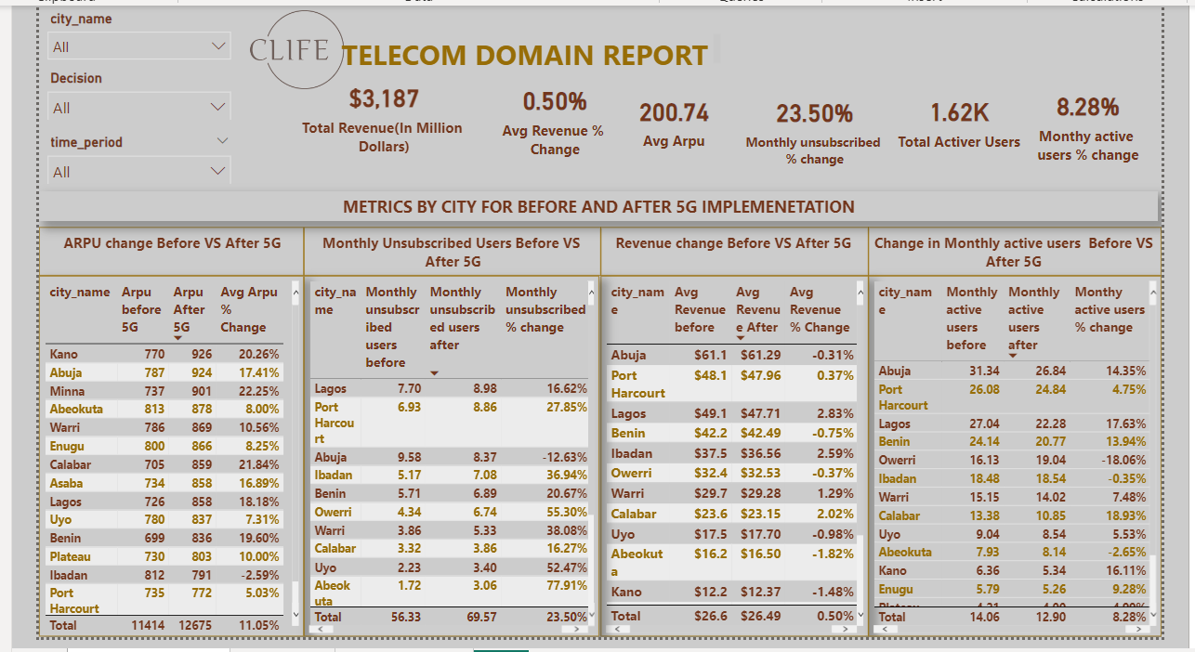
VISUALIZATION

Slide 8
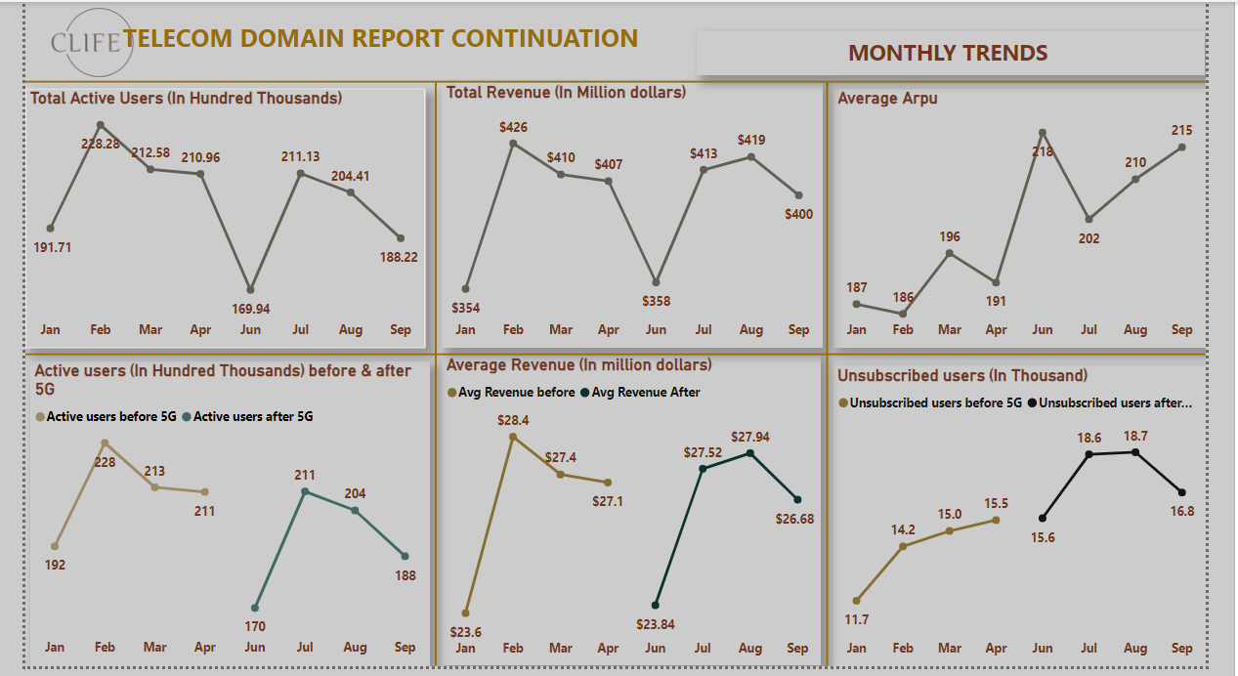
VISUALIZATION

Slide 9
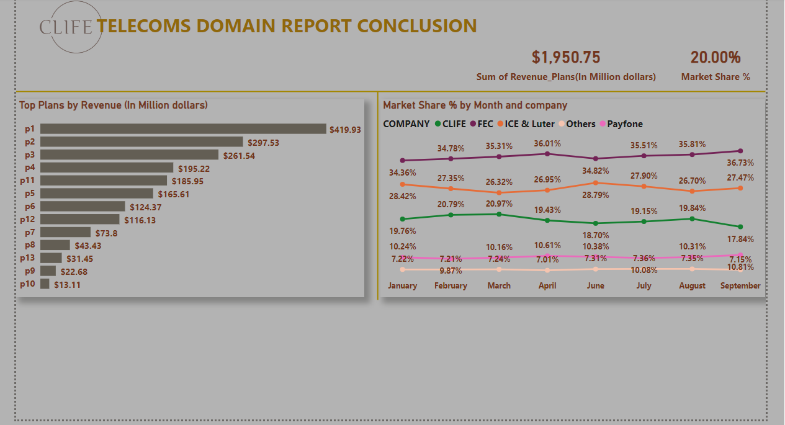
VISUALIZATION

Slide 10
INSIGHTS
METRICS BY CITY FOR BEFORE AND AFTER 5G IMPLEMENETATION
ARPU(Average Revenue per User) Before vs After5G:
Based on this chart the top 5 cities whose ARPU were positively affected by the introduction of 5G network are Kano(ARPU value moved from 770 to 926), Abuja(from 787 to 924) , Minna(from 737 to 901), Abeokuta(from 813 to 878) and lastly Warri(from 786 to 869) .
Monthly Unsubscribed Users Before vs After 5G:
With the introduction of 5G network, the following cities had the highest number of unsubscribed users.
Lagos ,moved from 7.7 thousand to 8.9 thousand unsubscribed users, Port Harcourt, from 6.9 thousand to 8.8 thousand unsubscribed users amongst others. Abuja recorded decrease in unsubscribed users from 9.58 thousand before 5G to 8.37 thousand users after 5G.
Revenue Change Before vs After 5G:
The introduction of 5G network had little to no effect on the Average revenue for most cities. Abuja recorded the highest revenue value of 61.2 million dollars after 5G, -0.31% change, and revenue of 61.1 million dollars before 5G.
Change in Monthly Active Users Before vs After 5G:
The cities with the highest monthly active users after 5G are Abuja (26.8 thousand users), Port Harcourt (24.8 thousand users), and Lagos(22.3 thousand users amongst others. When compared to other cities,Owerri had the highest number of new active users with increase in active users from 16 thousand users to 19 thousand users after 5G.
The company total revenue of 31.8 billion dollars.

Slide 11
INSIGHTS
MONTHLY TRENDS
Total Active Users:
The month of February had the highest number of active users 228,280 users, followed by march which had 212,580 active users. June had the lowest turn out of active users with a record of 169,940 thousand active users.
Total Revenue:
As expected due to the high number of active users in February, February had the highest revenue, 426 million dollars. Although August was the fourth month with most active users it generated the second highest revenue , 419 million dollars. The month with the lowest turnover is June with the revenue of 358 million dollars.
Active Users Before vs After 5G:
The month of January to April mark the pre 5G era and within this period February had the highest number of active users.
Upon the introduction of 5G in June the number of active users dropped to 11.3 thousand users. And from June onwards there was a steady increase in the number of active users which later ended with a decline in september.
Average Revenue Before vs After 5G:
Before 5G February had the highest average revenue of 28.4 million dollars, seconded by March with revenue of 27.4 million dollars. After 5G the average revenue fell to 23.8 million dollars, with steady climb it rose to 27.9 million dollars in August.
Unsubscribed Users Before vs After 5G:
Before 5G ,January had the lowest number of unsubscribed users, 11.7 thousand. With the value of 15.5 thousand , April had the highest number of unsubscribed users.
After 5G, the number of unsubscribed users was 15.6 thousand, over the month it rose to high value of 18.6 thousand and 18.7 thousand users in July and August respectively.

Slide 12
INSIGHTS
Top Plans by Revenue
The following plans generated the highest revenue:
P1(Smart Recharge Pack), revenue of 419.9 million dollars
P2(Super Saviour Pack), revenue of 297.3 million dollars
P3(Elite Save Pack), revenue of 261.54 million dollars
The Combo pack, Combo Top up and Big Combo Pack had lowest revenue being 22.6 million and 13.1 million dollar respectively.
Market Share% by Company and Month
When comparing CLIFE with other companies, these are the months with highest and lowest Market Share Value;
CLIFE: The highest Market Share value was recorded in April, 20.9%, and the lowest in June, 18.7%.
FEC: it had the highest Market Share value in September, 36.7% and lowest in January , 34.36%.
ICE & Luter : It recorded its highest Market Share value of 34.8% in June and its lowest in March ,26.3%.
Payfone: It did not record drastic increase or decrease in market share value . Its highest value being 10.89% in September and lowest 9.87% in February.

Slide 13
RECOMMENDATION
CONCLUSION:
Introduce Referral Programs to clients:
Give active subscribers discount on their current plan whenever they bring a referral or give them a one-month free subscription.
Bundle 5G services
This is easier for new customers, mix your standard offerings with the premium plan and create an irresistible bundle. This could help steal customers from the competitors. Compare the plans that they are offering with what is on ground, and create competitive packages that are irresistible to your customers.
Focus more on customer retention:
Keep the current customers happy by increasing customer loyalty. Apply the following strategies:
Introduce loyalty program
Take extreme measures to improve customer service
Keep doing surveys to understand what your customers feel about your service and what they would like you to improve.
Reward loyal customers:
Reward customers by issuing gift cards or adding something for free to their service bundle. Also give discounts on extended services as this gives them better rates, and they are more willing to continue with our services.

Slide 14
THANK YOU!

